Slide 1




Best Campaign in February 2019
BukaToko
Best Campaign Objective, Channel, OS, Conversion Event
We provide insights of BukaToko February 2019 marketing campaign for the best marketing strategy on March 2019
Types of Error that Mostly Happen to the User
Campaign that not as Successful as the Test Campaign

Slide 2
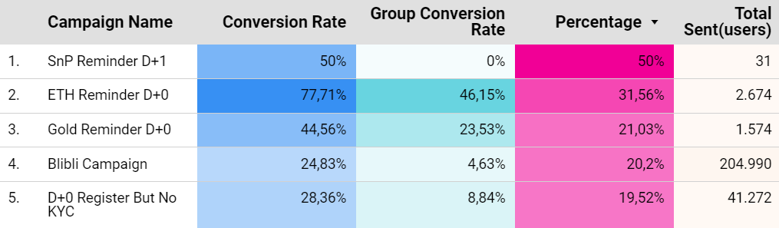
Best Campaign in February 2019
ETH
Reminder D+0
31.56% Percentage (CR - Group CR)
With total Conversion Rate
77.71%
From the data above, SnP Reminder D+1 has the highest percentage gap between the group conversion rate and conversion rate (basically the percentage of the difference if campaign held or not), which makes this campaign could be the best. But in our opinion, the ETH Reminder D+0 campaign is the best because in SnP Reminder D+1 data is only taken from a total of 31 users, while ETH Reminder D+0 has been held twice and reached 2,674, one of the campaigns has also reached 46.5% which indicates that the target market of this campaign is more specific and the conversion event is more achieved. The total error from this campaign is only 6 errors, so in our opinion, the ETH Reminder D+0 campaign is the best.

Slide 3
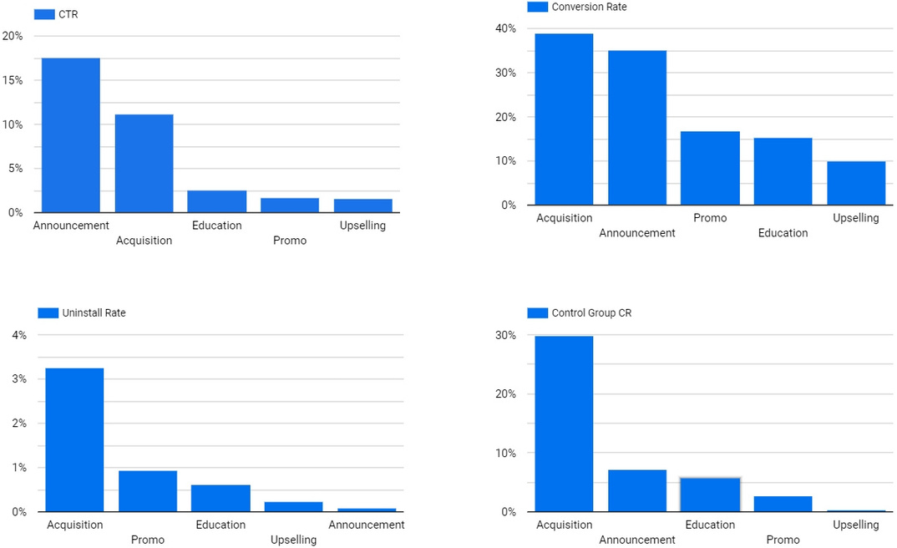
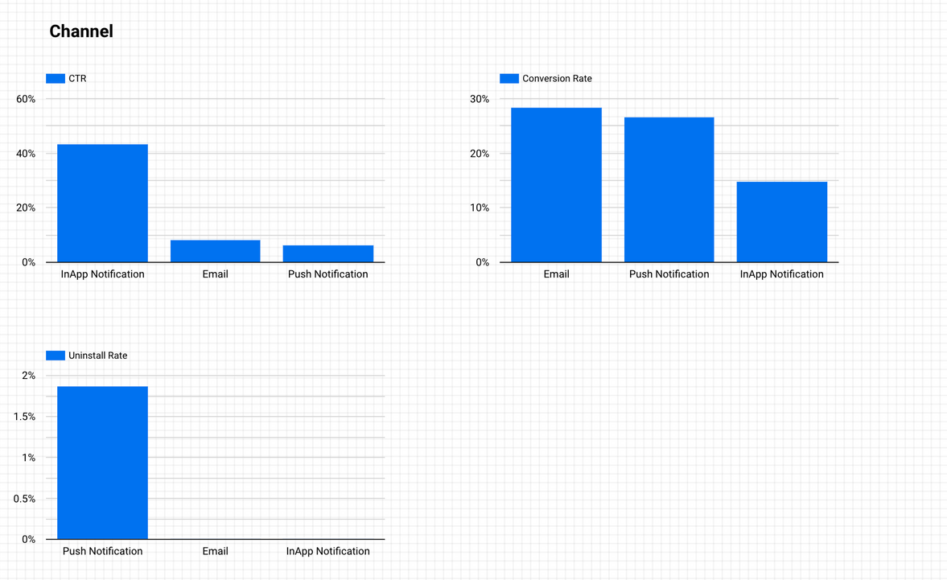
Best Campaign Objective and Channel
The best campaign objective: Announcement
Highest CTR (17,54%)
Highest difference between CR and Control Group CR (27,9%)
Lowest Uninstall rate (0,09%)
The best campaign channel: Inapp
Highest CTR (43,24%)
High Conversion Rate (14,7% out of total clicked)
Lowest Uninstall rate (0%)

Slide 4
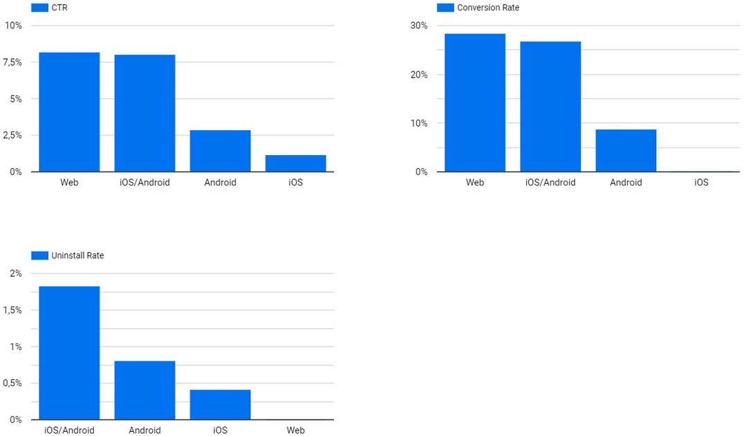
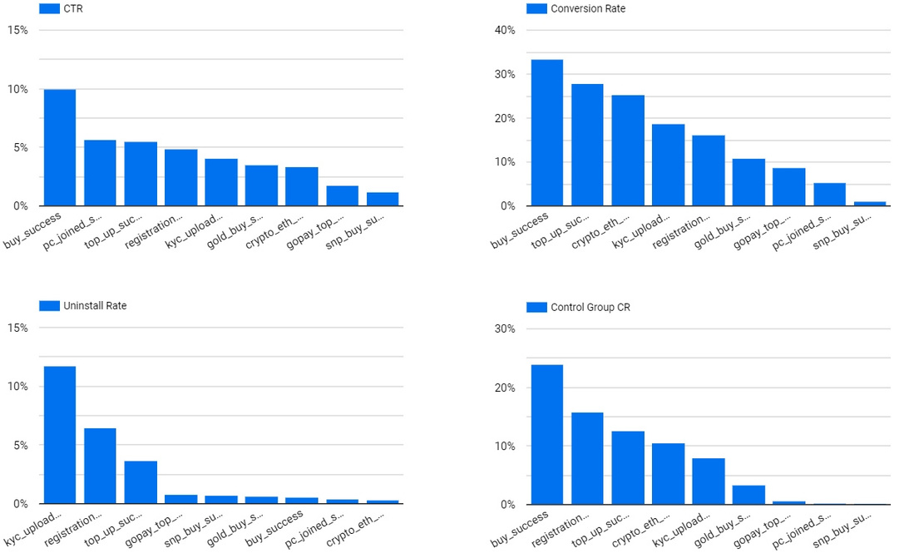
Best Campaign OS and Conversion Event
The best campaign OS: Web
Highest CTR (8,8%)
Highest Conversion Rate (28,4%)
Lowest Uninstall rate (0%)
The best campaign conversion event: buy_success
Highest CTR (10%)
Highest Conversion Rate (33,38%)
Lowest Uninstall rate (0,58%)
Even though it has a high control group CS, buy_success still perform the highest in it's CTR almost 2 times higher than other events

Slide 5
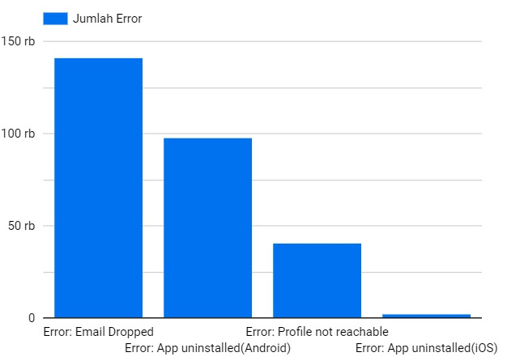
Types of Error That
Mostly Happen to the User
Email
Dropped
140.974 from 282,100 error
From the chart on the right, the type of error that mostly happens to the user is Email Dropped, as many as 140.974 from the total of 282,100 users, and the least error type is App Uninstalled(IOS) with only 2.404.

Slide 6
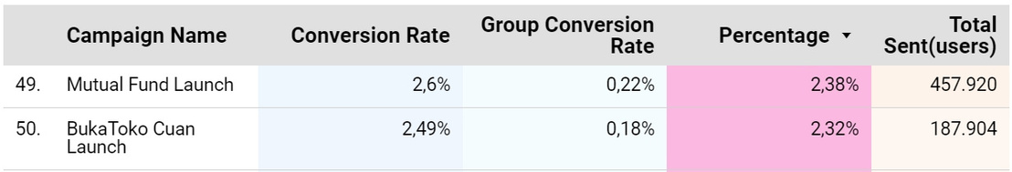
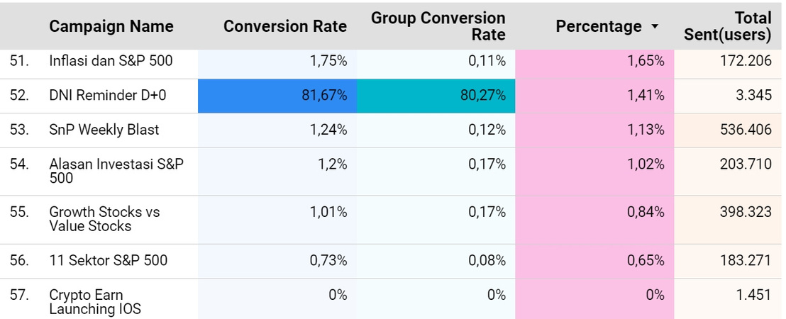
Campaign that not as
Successful as the Test Campaign
Test
Campaign
2.35% Average Percentage
Mutual
Fund Launch
2.38% Percentage
BukaToko
Cuan Launch
2.32% Percentage
On the left is a list of campaigns that are not as successful as the Test Campaign because they are below the percentage from the Test Campaign, which is 2.35%
We only take the Top 7 because the data below gives better results in the group conversion rate, which means the campaign is unsuccessful.

